Slide 1
Performance
The more connected your data is, and the more complex your query is, the faster graph technology is at processing your requests.
With no need to translate requests into non-graph methods or syntax, Neo4j delivers fast, accurate results for even complex queries of connected graph data.
Relational approaches are appropriate for tabular data with static schemas, but not for the demands of highly connected or changing datasets.
index-free adjacency to traverse millions of data records with sub-second response times, even when those queries mine data several layers deep.
Graph databases are designed to traverse stored data very quickly and retrieve results in milliseconds.
Exceed performance expectations when traversing relationships among data for data science and analytics purposes where decision making is required.

Slide 2
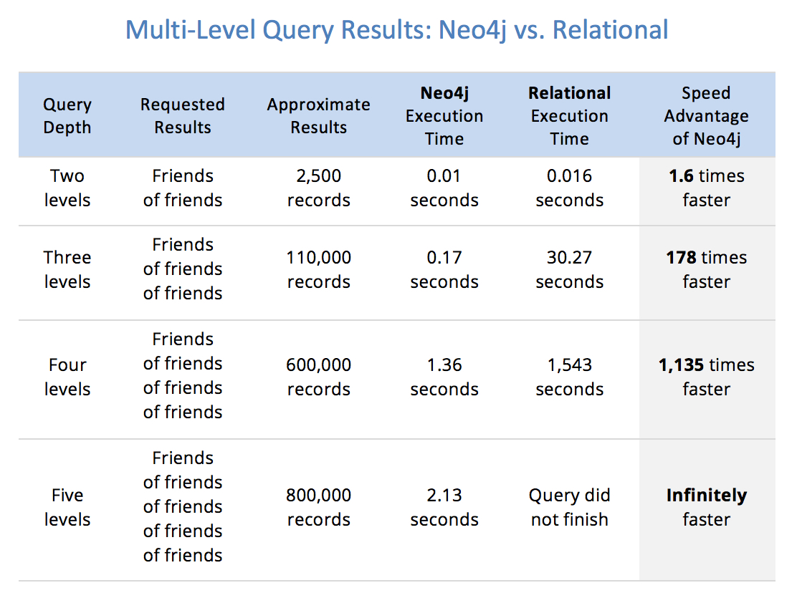

Slide 3
Application slide
The Neo4j graph database platform can be used for a wide variety of business applications, but there are many for which native graph technology is absolutely required to meet performance and reliability requirements. Some samples of those applications appear below.
Retail and E-Commerce (eg : Walmart, fortune 50)
Purchase history recommendations
Peer recommendations
Social and Business Networks (eg : LinkedIn, gamesys)
Friendship and relationship sites
Professional networks and organizations
Event recommendation and review sites
Membership and organization management
Information Management
Identity and access management
Master data management
Network operations
Internet of Things and sensor monitoring
Support case solution

Slide 4
Customer and Sales Management (eg : eBay, Medium.com)
Prospect identification
Product recommendation
Finance (eg : Citi Bank, UBS bank, Global 50 bank)
Identity and access management
Fraud detection
Product and service recommendations
Healthcare (eg : Novartis)
Care provider recommendations
Clinical data analysis and bioinformatics
Insurance fraud
Logistics (eg : Transparency One, Volvo, Caterpillar, Airbus)
Real-time routing
Supply-chain management and risk assessment

Slide 5
https://neo4j.com/customers/?ref=home
Go here to see all customers and add images maybe (optional)

